Slide 1
Thoughts on reproducibility
Lex Nederbragt
With input from Geir Kjetil Sandve
Dept. of Informatics, UiO

Slide 2




whoami
@lexnederbragt
flxlexblog.wordpress.com

Slide 3
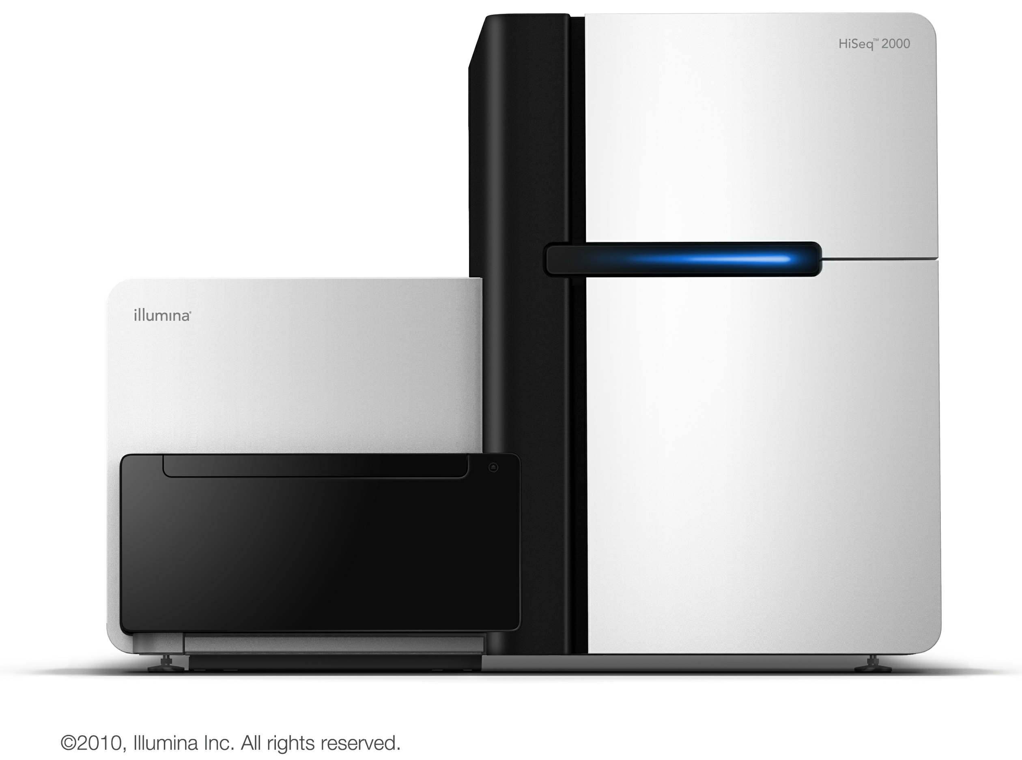
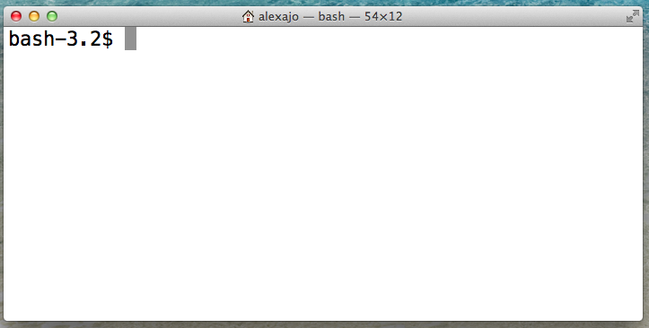
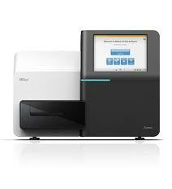
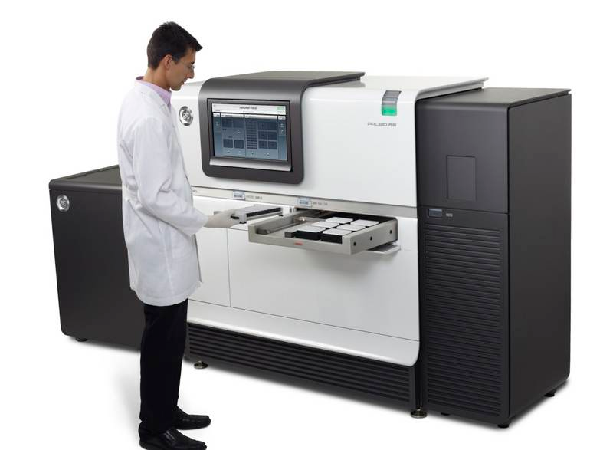
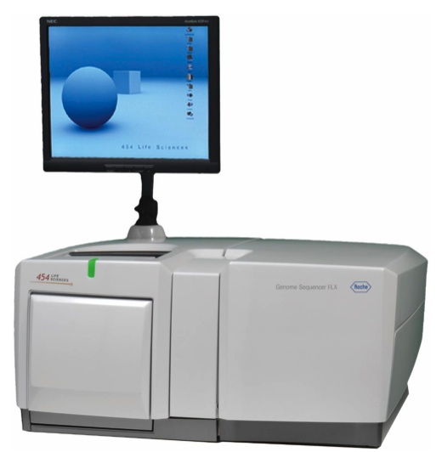
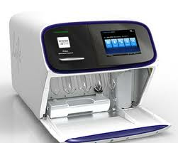
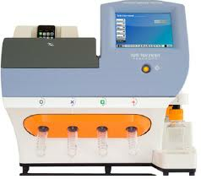
whatdoido

Slide 4
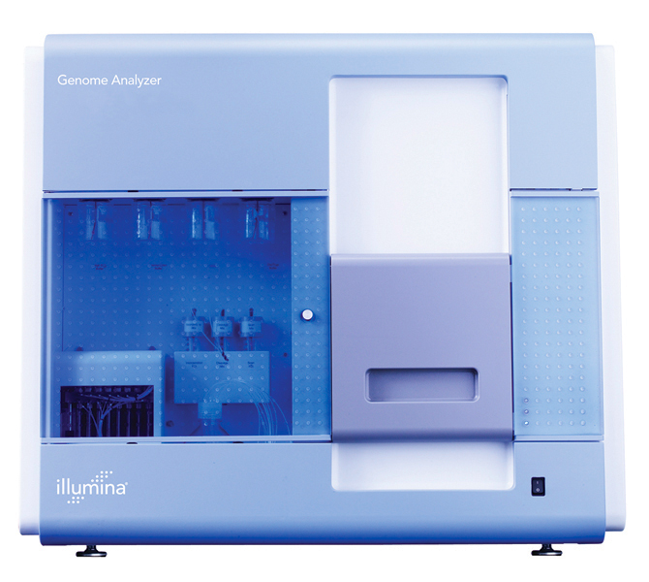
howdidistart
2007: a grant
?
GS FLX from Roche/454
Genome Analyzer from Solexa/Illumina
Let’s try them out!

Slide 5
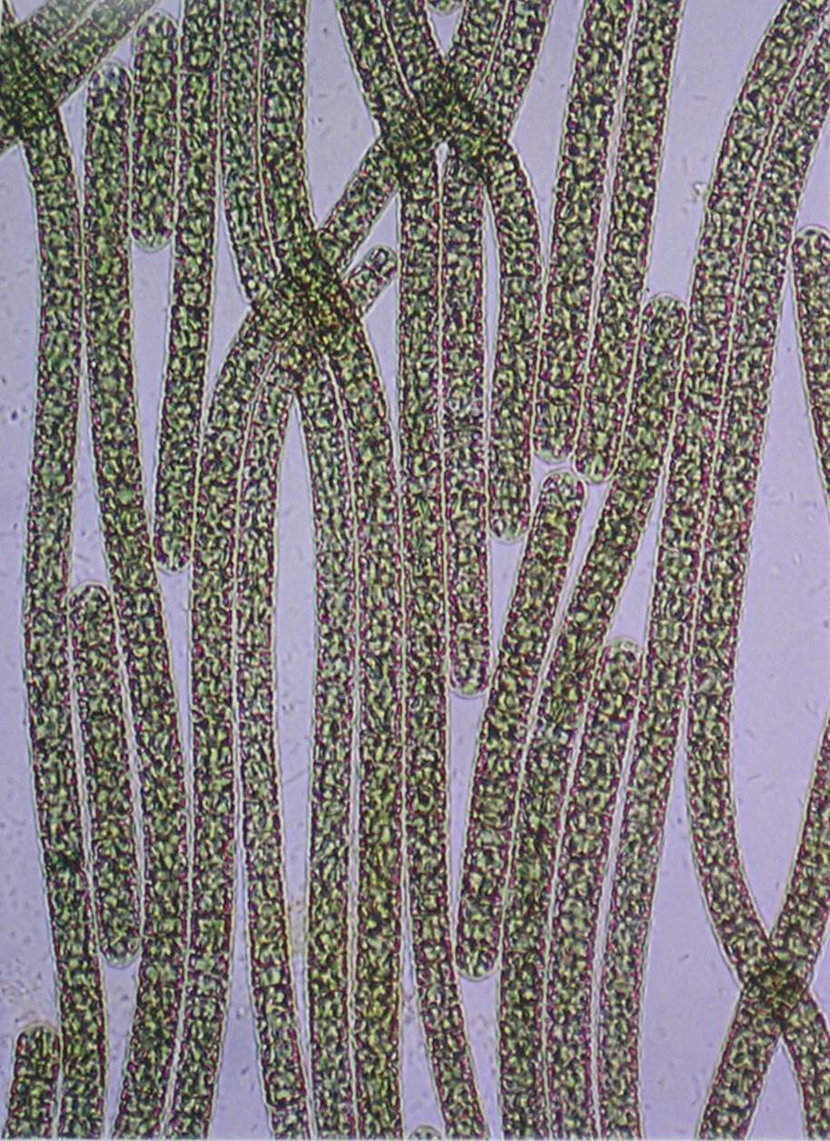
howdidistart
Specimen
Planktothrix rubescens NIVA CYA 98
Cyanobacteria
(blue-green algae)

Slide 6
howdidistart
Half a million reads
Average length 250 nt
10 million reads
33 nucleotides each
Assembly?
Assembly?

Slide 7

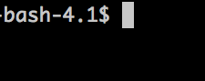

howdidistart
Half a million reads
Average length 260 nt
10 million reads
33 nucleotides each
Perl

Slide 8

In summary
From flickr, user lesterpubliclibrary

Slide 9

What is ‘Reproducible research’?
“Reproducibility is the ability of an entire experiment or study to be reproduced
either by the researcher or by someone else working independently.
It is one of the main principles of the scientific method.”
Wikipedia

Slide 10
Reproducibility: why?
TRUST

Slide 11

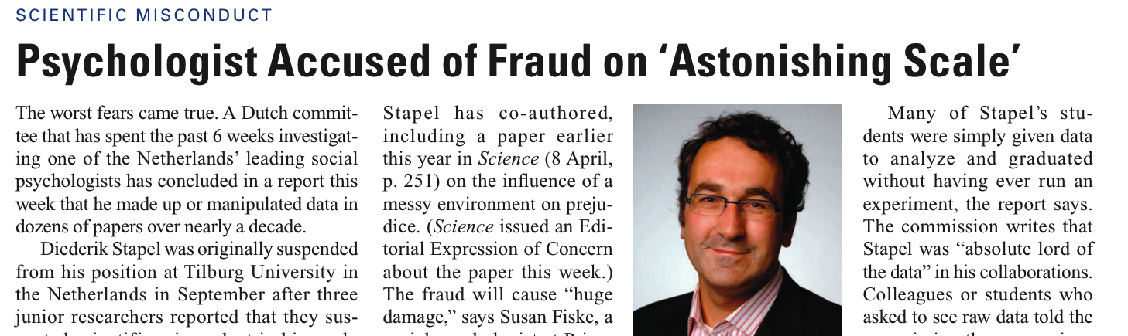
The worst case
https://www.sciencemag.org/content/334/6056/579.full.pdf

Slide 12
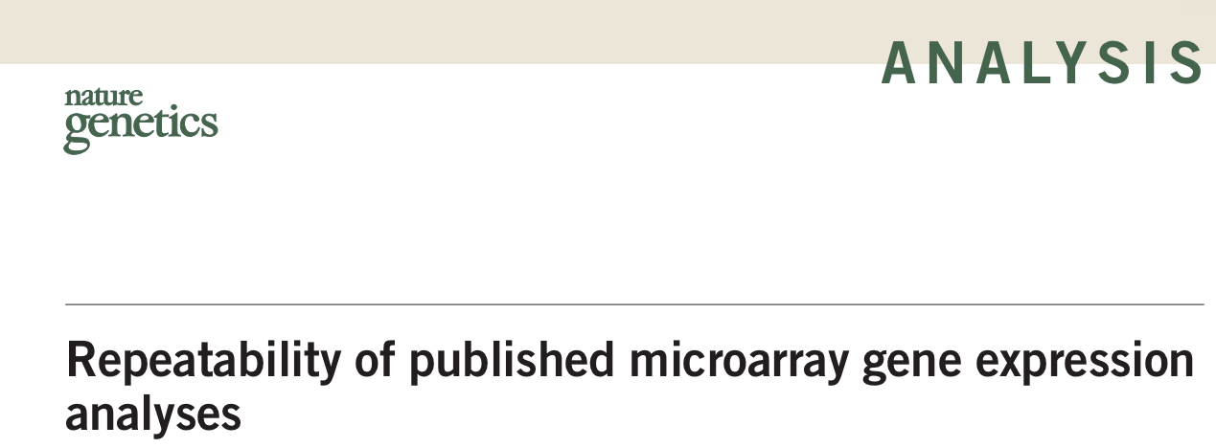
How bad is it?
Nat Genet 41(2):149-55
Less than half of selected microarray experiments published in Nature Genetics could be reproduced

Slide 13
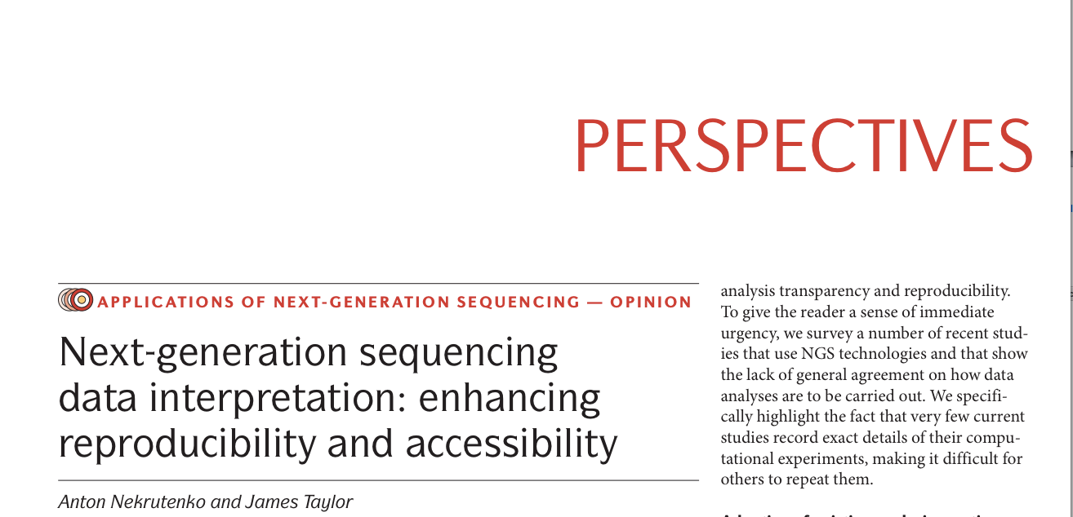
How bad is it?
Nat Rev Genet 13(9):667-72
Nat Rev Genet 13(9):667-72
“More than half [of surveyed papers] do not provide primary data and list neither the version nor the parameters used [for read mapping]”

Slide 14
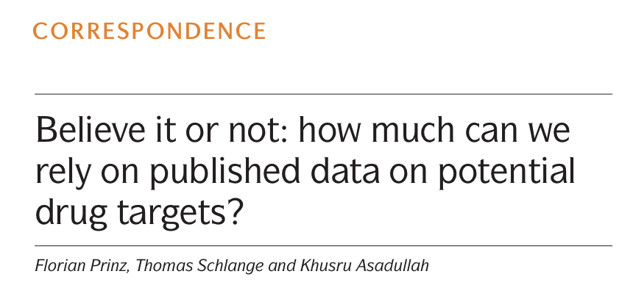
A reproducibility crisis?
Nat Rev Drug Discov. 10(9):712)
Lack of reproducibility related to a sharply increasing rate and failed clinical trials?

Slide 15
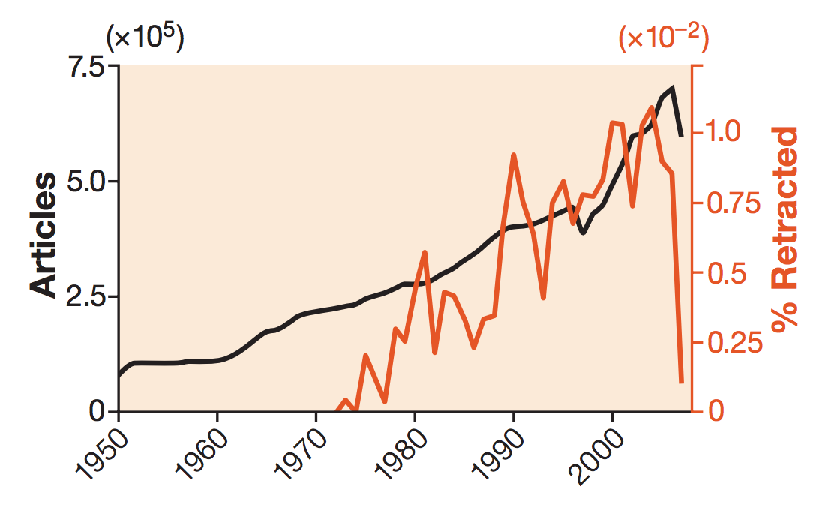
A reproducibility crisis?
Retraction rates are on the rise Murat Cokol, Fatih Ozbay & Raul Rodriguez-Esteban
EMBO reports (2008) 9, 2 doi:10.1038/sj.embor.7401143

Slide 16
An example from our own work
2011

Slide 17
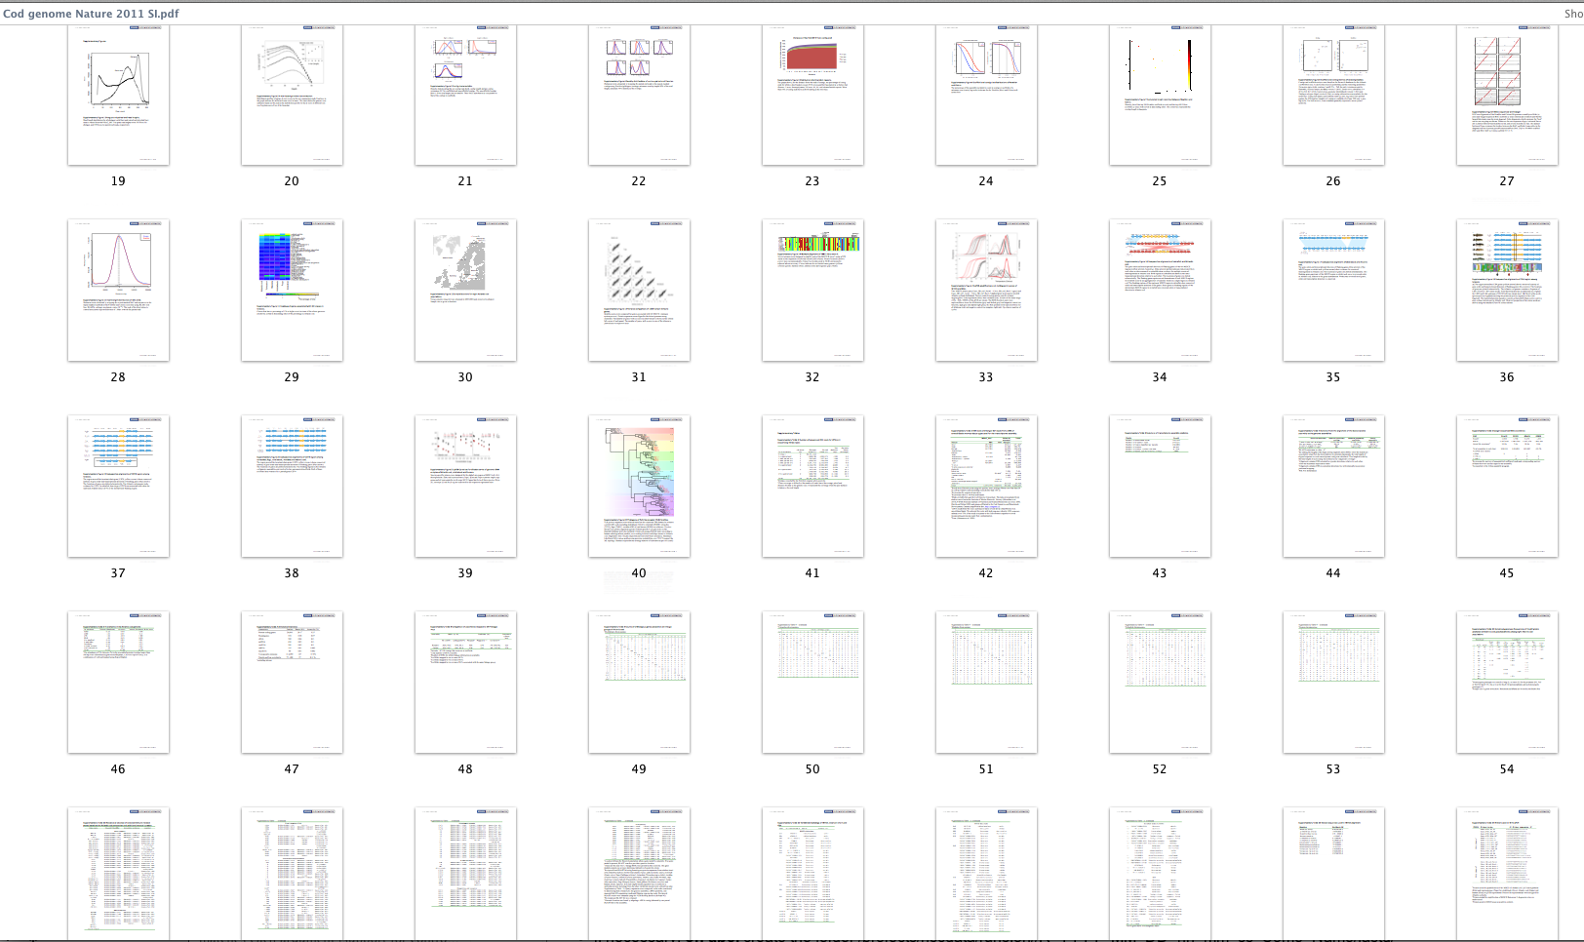
An example from our own work
Are all these figures/tables reproducible?
Supplementary information, page 19-63 of 72

Slide 18
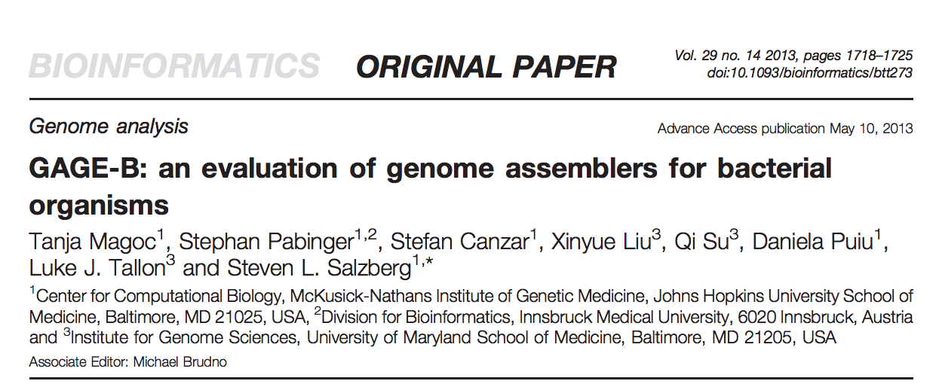
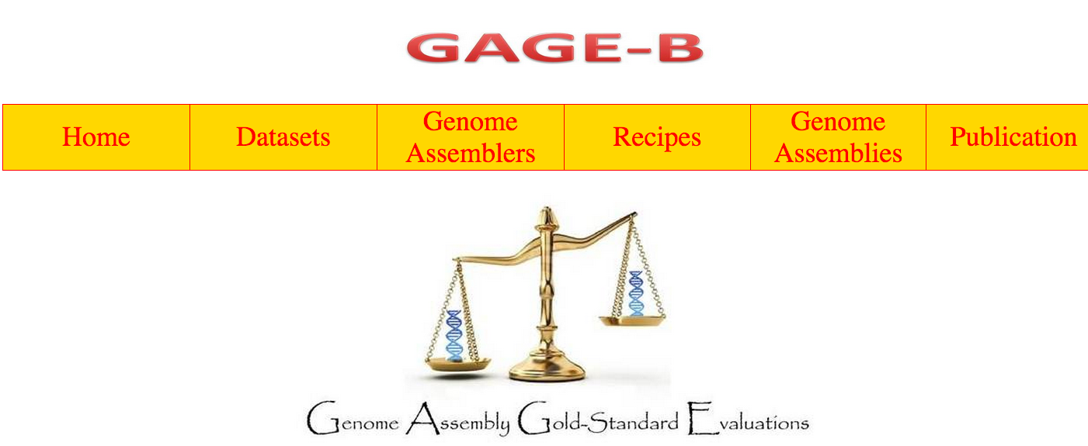
An exercise in reproducibility
Master student project at informatics Sabba Ifzal

Slide 19
Blast

Slide 20
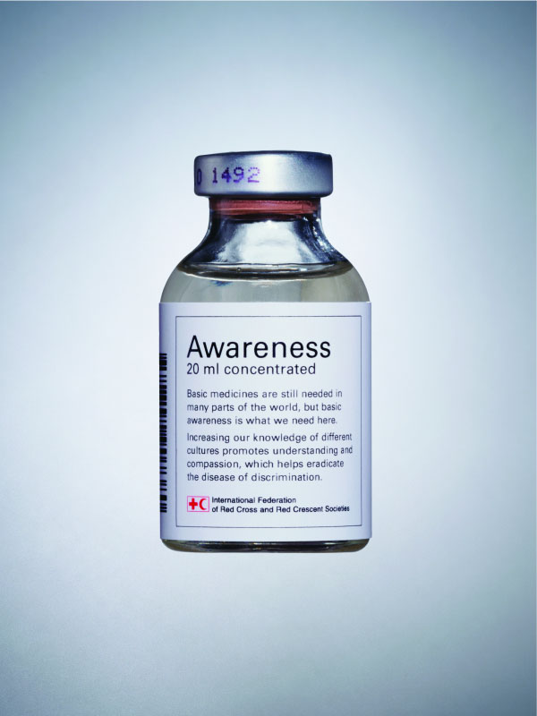
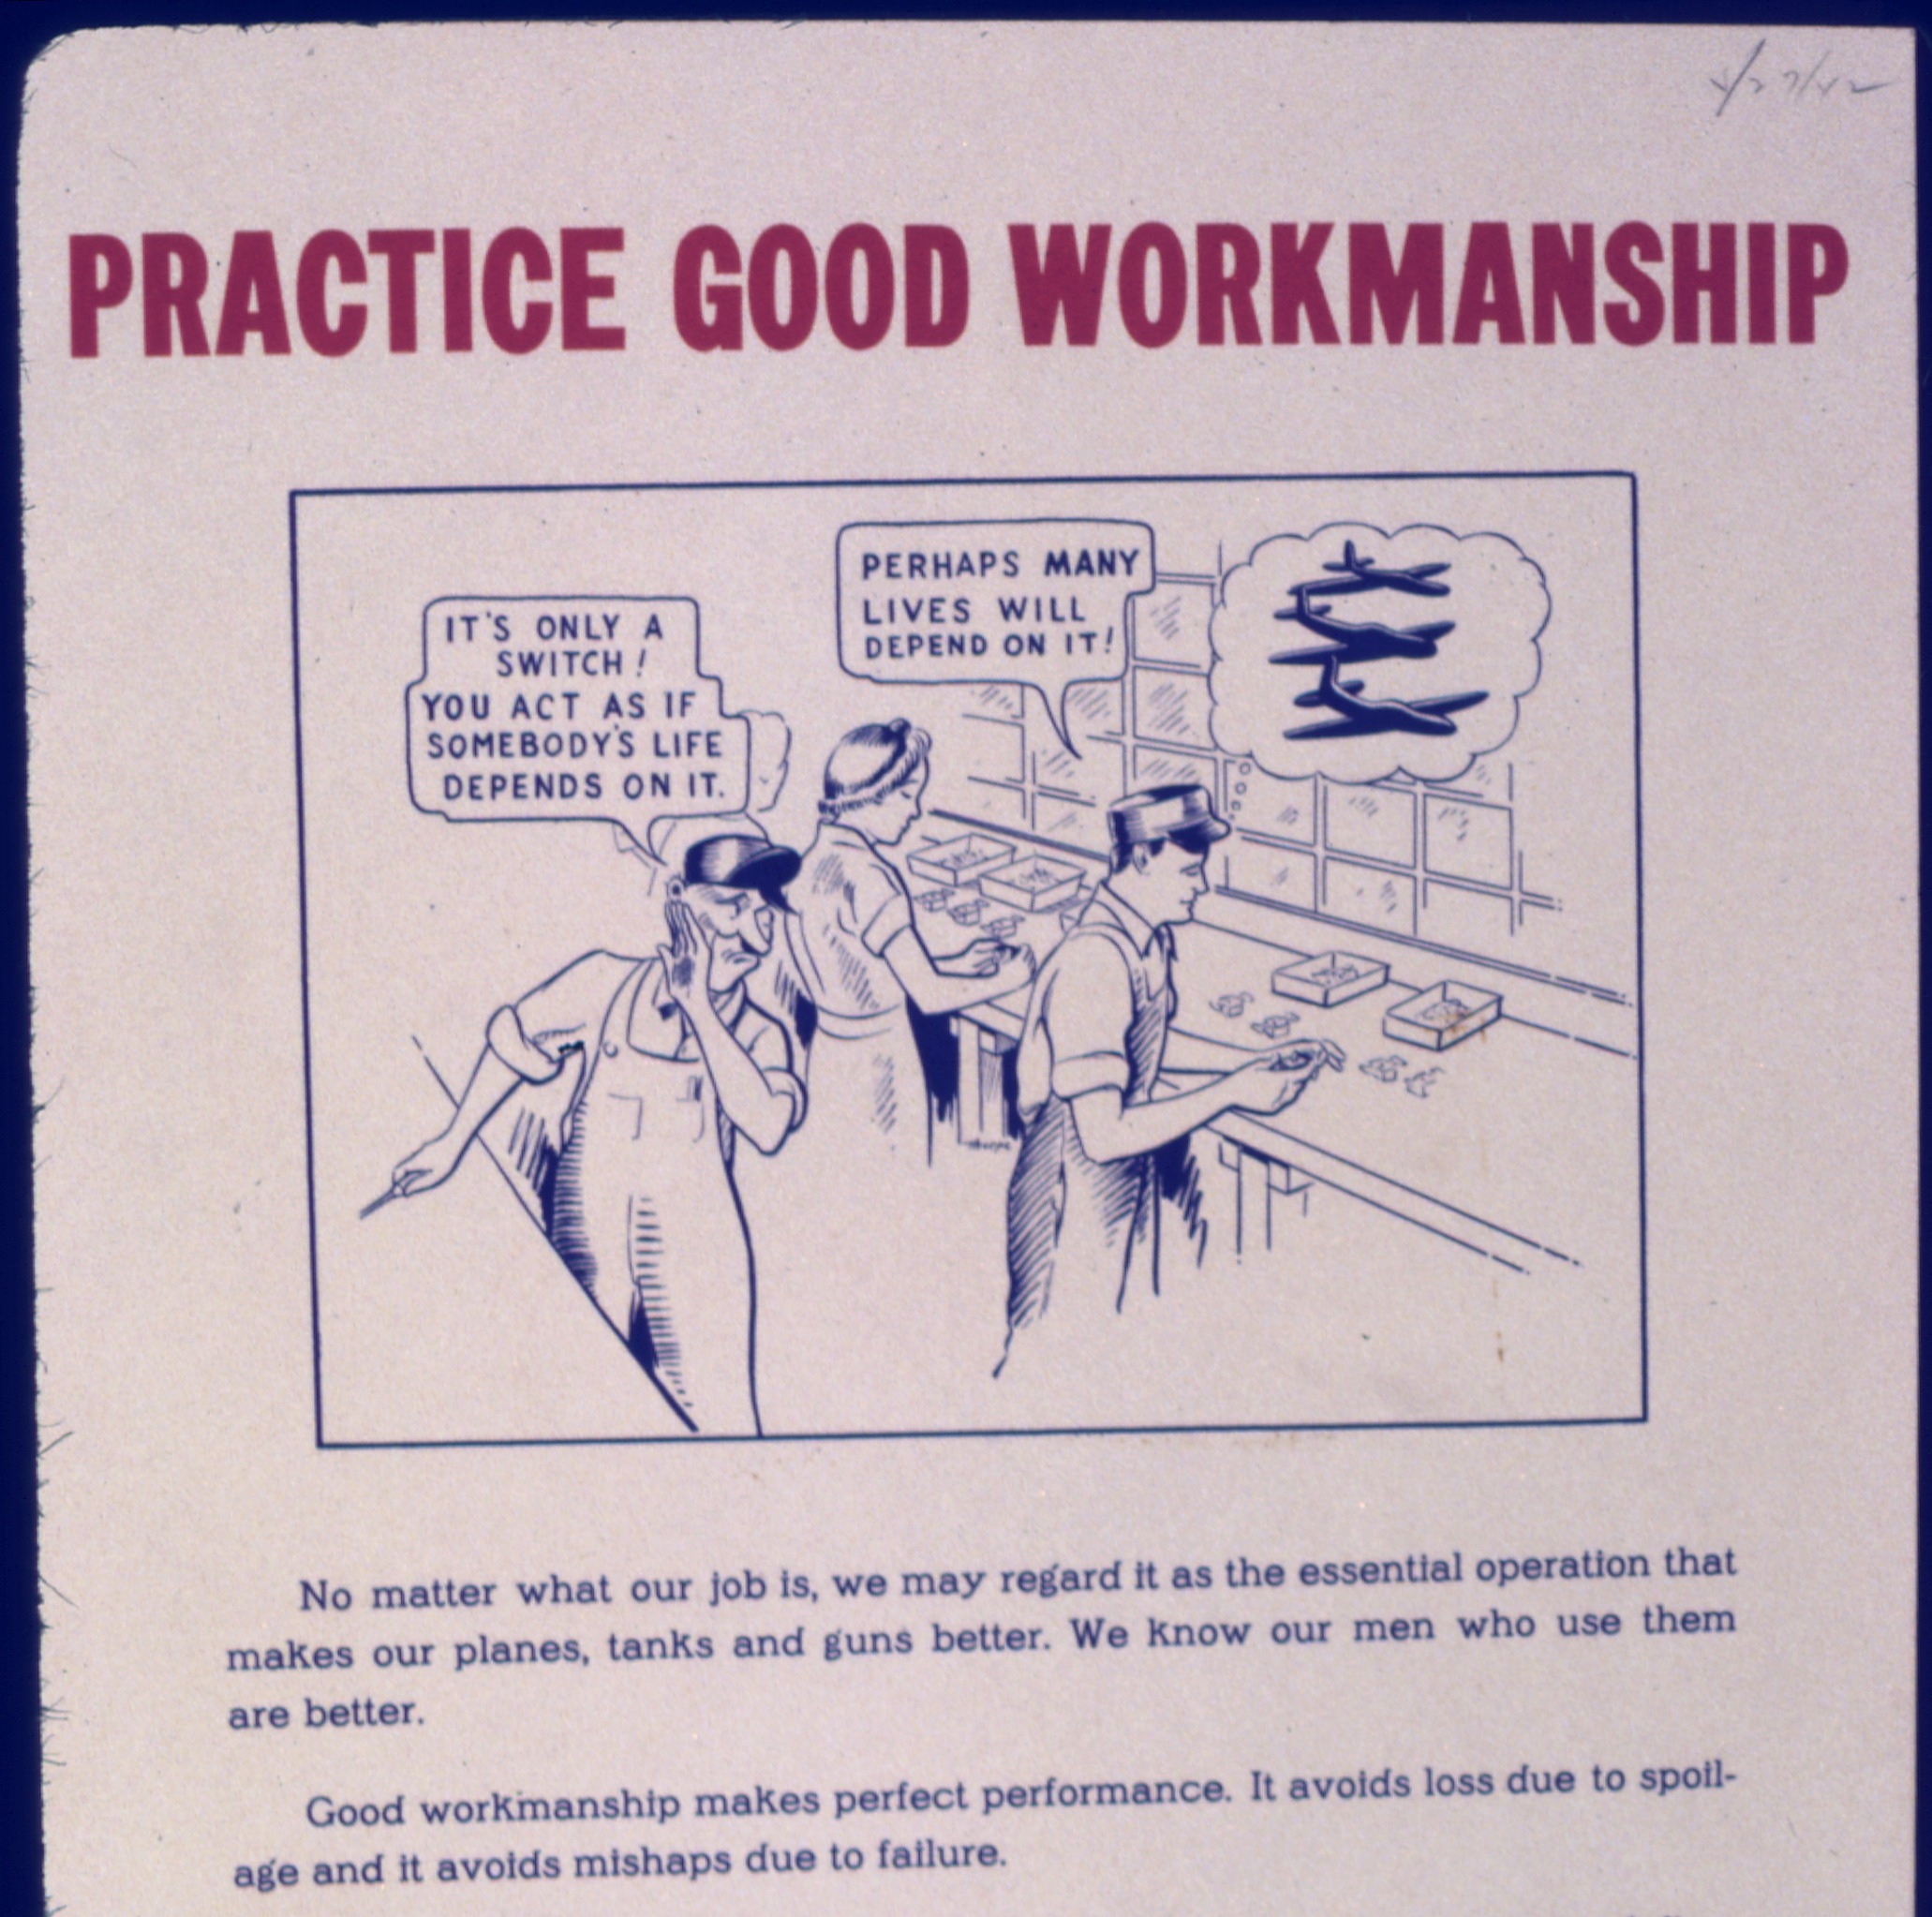
Solutions
Flick: http://farm4.staticflickr.com/3319/3265787219_bfbc654b5e_o.jpg
Wikimedia commons

Slide 21
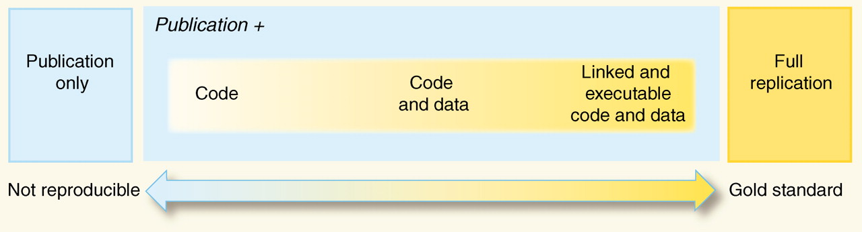
Reproducibility spectrum
Peng (2011) doi: 10.1126/science.1213847

Slide 22

Reproducibility and reusability
http://upload.wikimedia.org/wikipedia/commons/4/48/Recycle.jpg

Slide 23
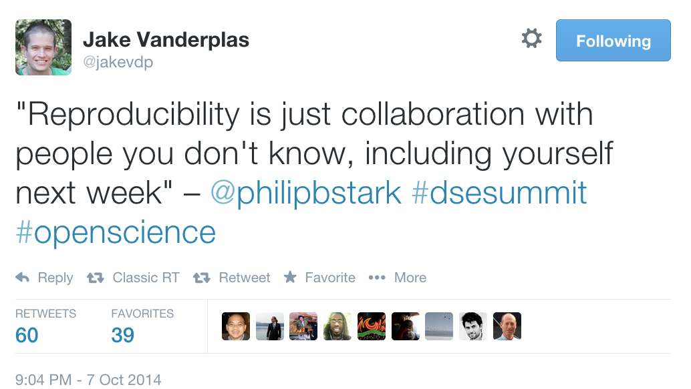
Reproducibility: why?

Slide 24

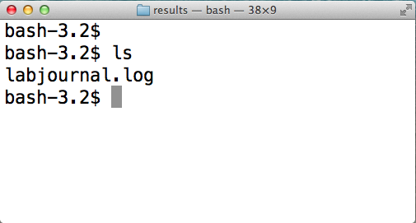
How to make your research reproducible
Document your work

Slide 25
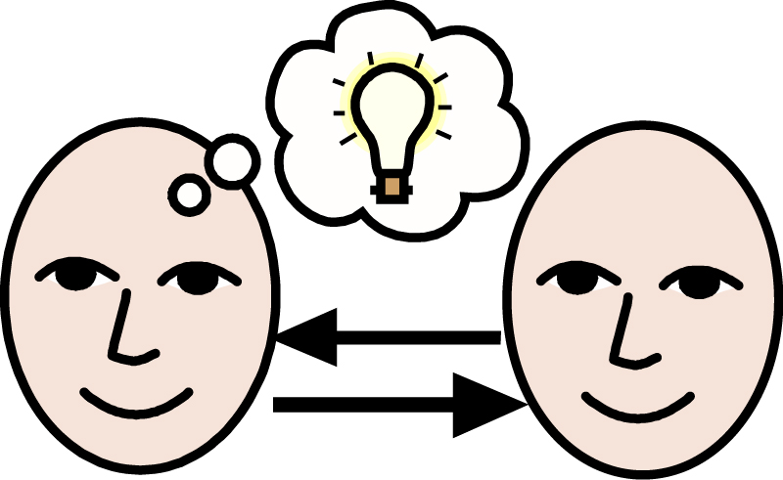
How to make your research reproducible
SHARE
http://howdoitradestocks.com/wp-content/uploads/2011/12/share-ideas1.jpg

Slide 26
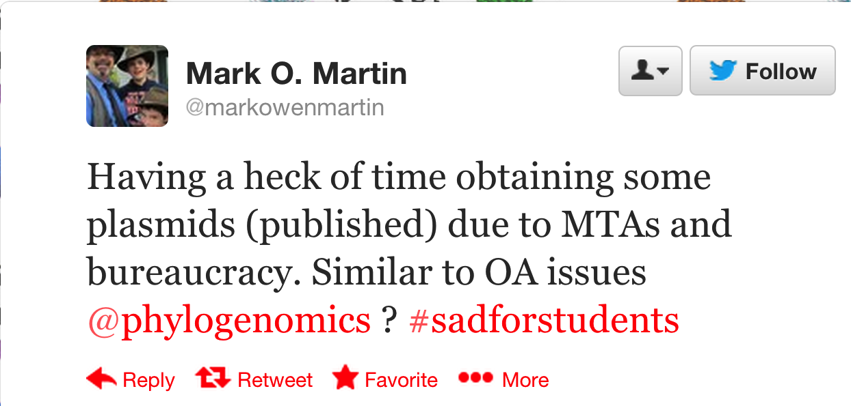
How to make your research reproducible
SHARE
https://twitter.com/vsbuffalo/statuses/377651287133003776

Slide 27
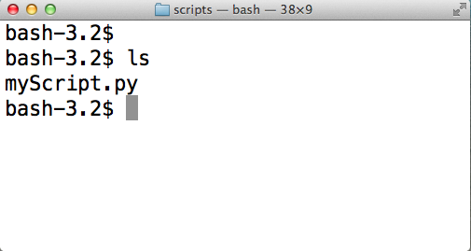
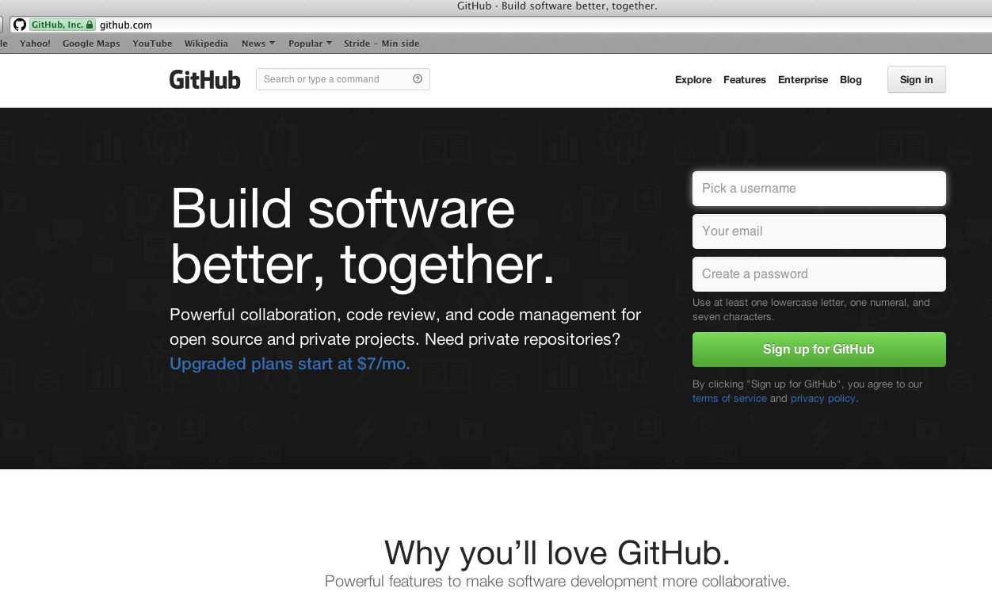
How to make your research reproducible
https://github.com/lexnederbragt
SHARE

Slide 28
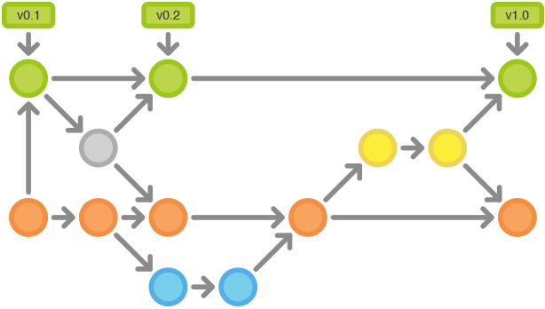
How to make your research reproducible
Version control
https://www.atlassian.com/git/workflows

Slide 29

How to make your research reproducible

Slide 30


How to make your research reproducible
http://software-carpentry.org
http://www.datacarpentry.org

Slide 31
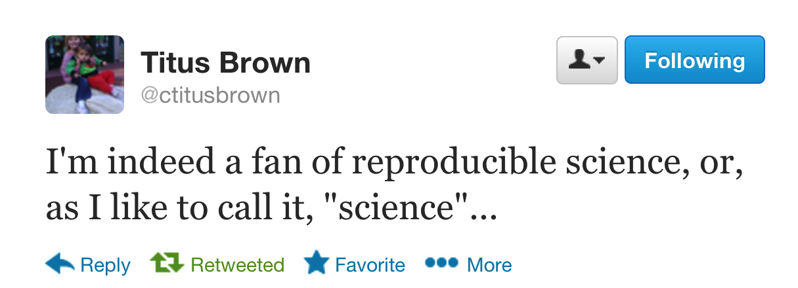
https://twitter.com/ctitusbrown/status/383730337811296256

Slide 32
Group exercise
In groups of two, describe:
Which tools you currently use to do your bioinformatics work
How you could use those tools (better) to make your work (even) more reproducible
Which tools you think could help to make your work (even) more reproducible, but that you currently do not use
Log your results at bit.ly/INFBIO4

Slide 33
Interacting with bioinformatics functionality
Modified from Geir Kjetil Sandve, institute of informatics, UiO

Slide 34
What tools can/do you use?

Slide 35
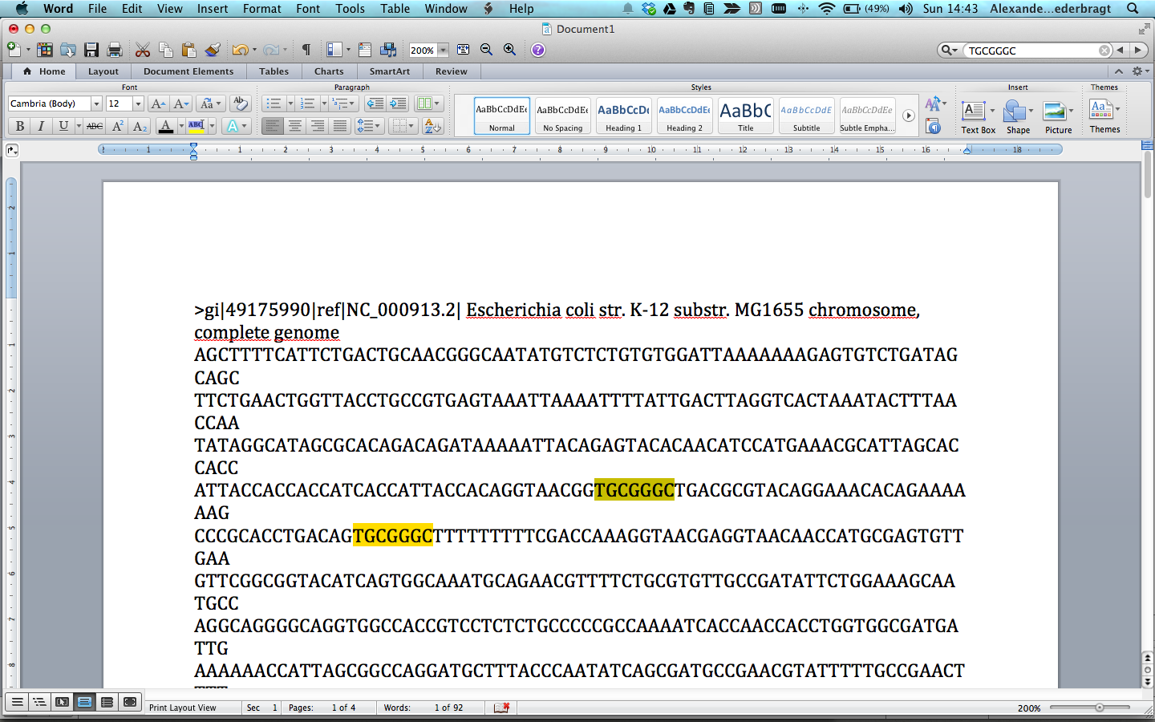
Microsoft Word
✔Possible, familiar environment
✖ impractical, limited, not very reproducible

Slide 36
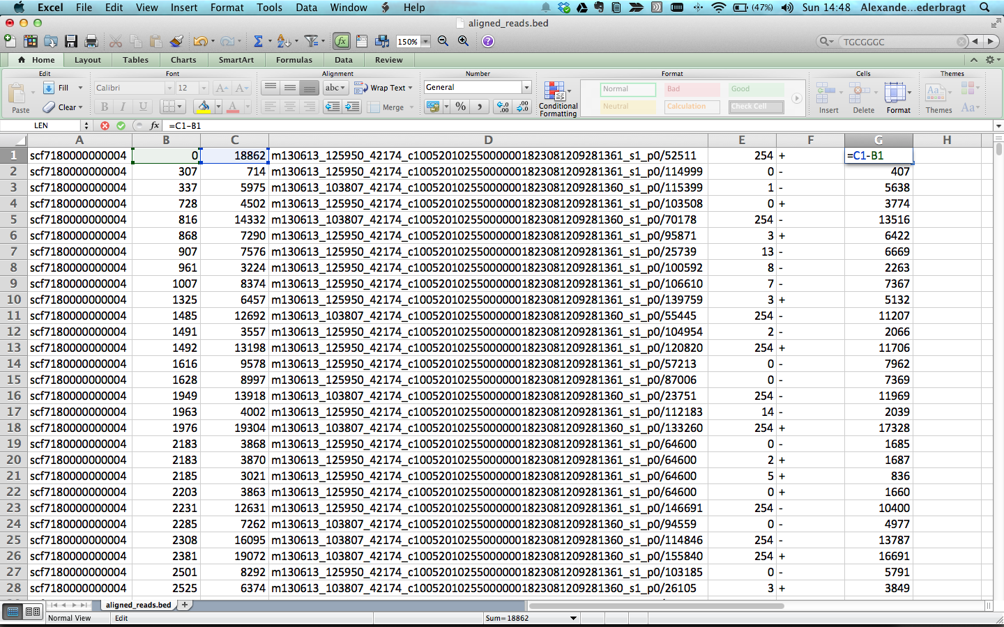
Microsoft Excel
✔Possible, somewhat powerful
✖ limited, not very reproducible

Slide 37
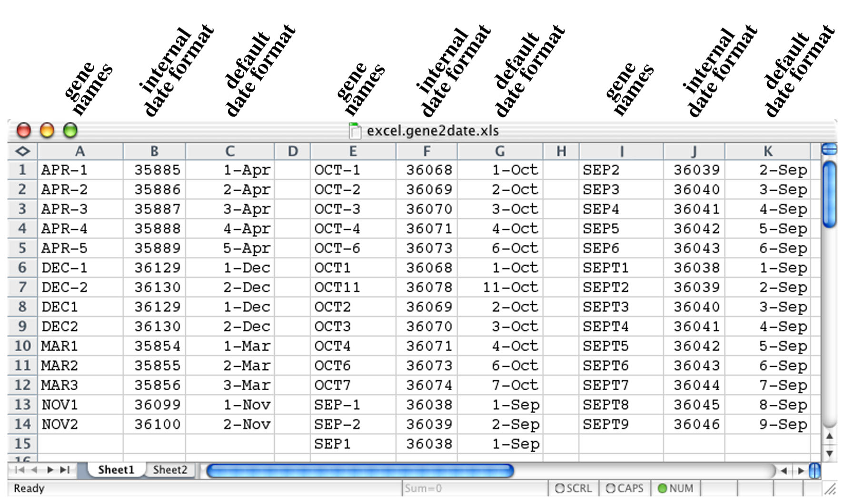
Microsoft Excel
Gene names – oh oh…
BMC Bioinformatics 2004, 5:80 doi:10.1186/1471-2105-5-80

Slide 38
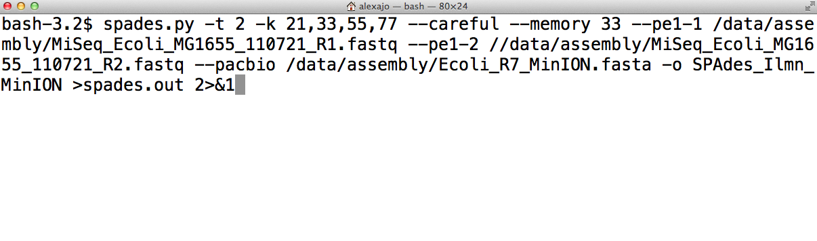
Unix shell
✔Powerful, close to operating system, many tools
✖ Steep learning curve, dependency hell

Slide 39
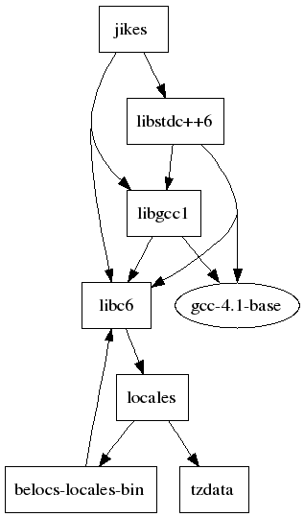
Unix shell
Constant stream of new software
hard to judge if programs are
any good
sometimes a challenge to
install a program and
get it working
http://neidetcher.com/ubuntu_package_dependency.html

Slide 40
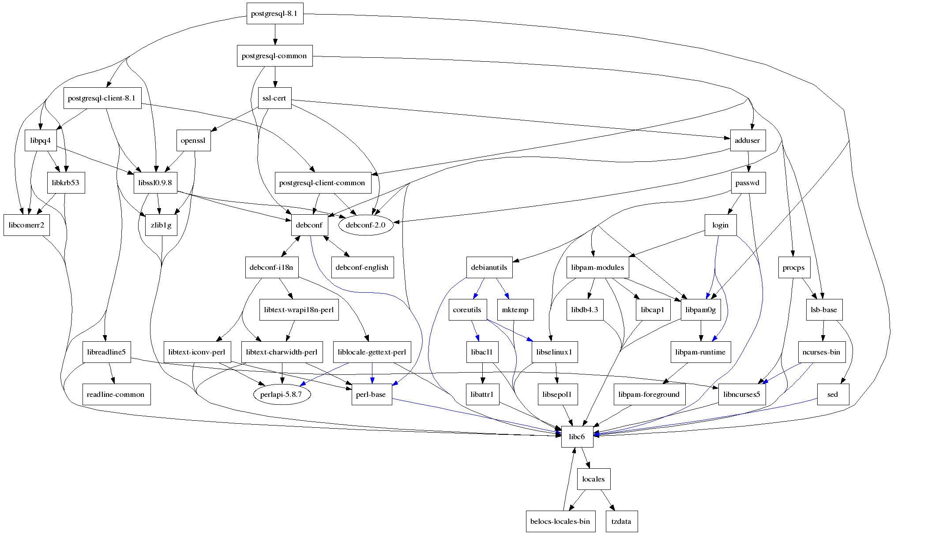
Dependency hell
http://neidetcher.com/ubuntu_package_dependency.html

Slide 41
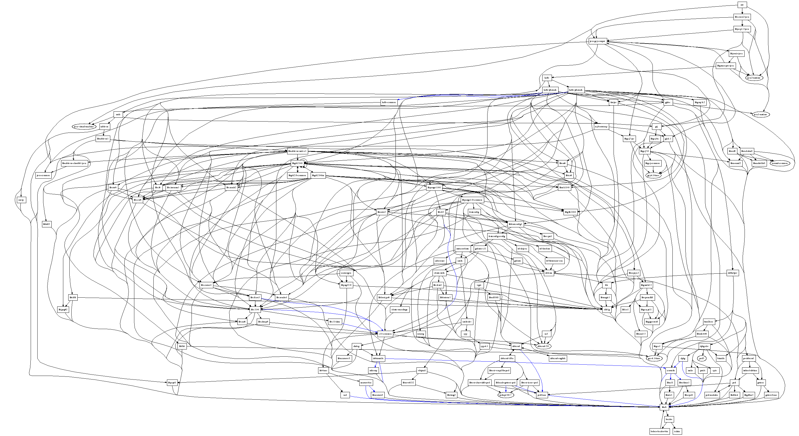
Dependency hell
http://en.wikipedia.org/wiki/Dependency_hell
http://neidetcher.com/ubuntu_package_dependency.html

Slide 42
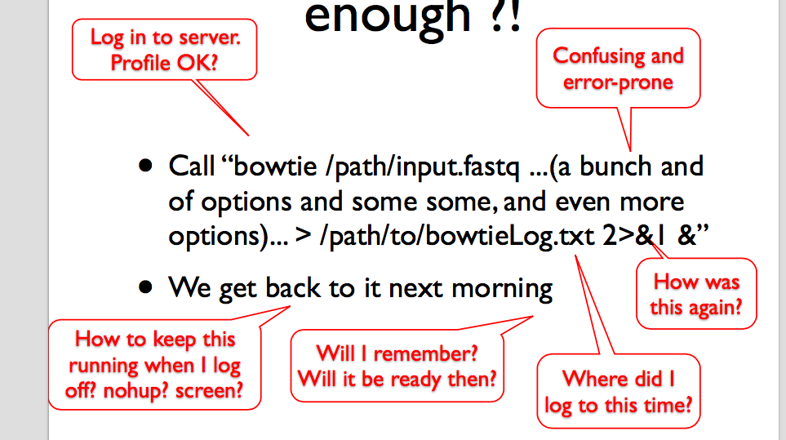
Shell command ‘language’
Sveinung Gundersen, this course

Slide 43
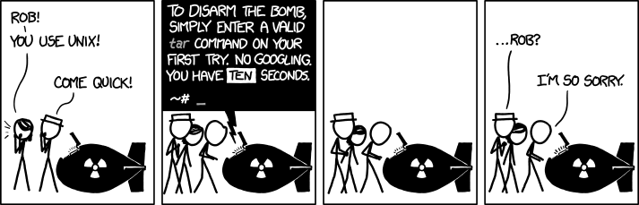
Shell command ‘language’
xkcd.com/1168

Slide 44
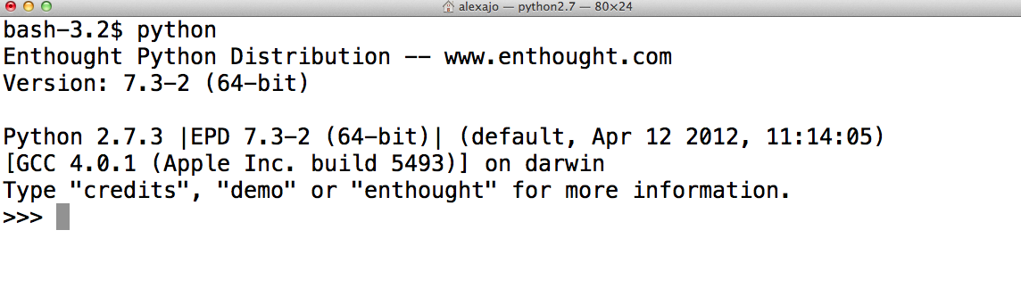
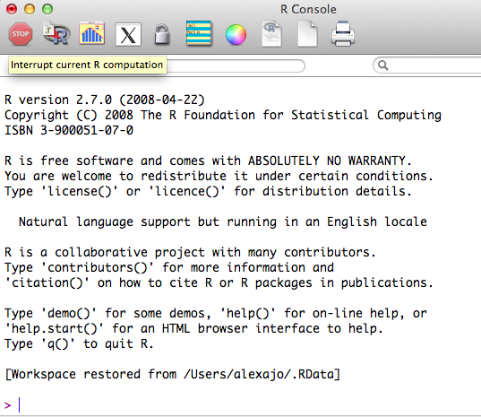
Programming language
✔Powerful, flexible
✖ Learning curve, package/module management

Slide 45
Python versus R
✔Real programming language, easy to learn
✖ Not yet optimal for (bio)statistics
✔Lots of (bio)statistics modules, plotting
✖ Not a good programming language

Slide 46
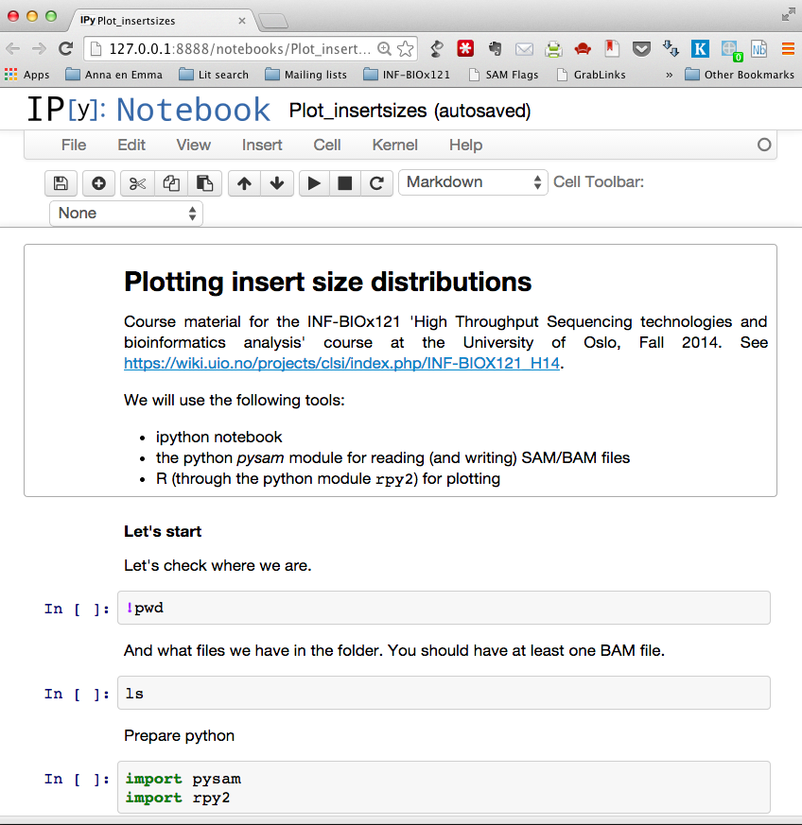
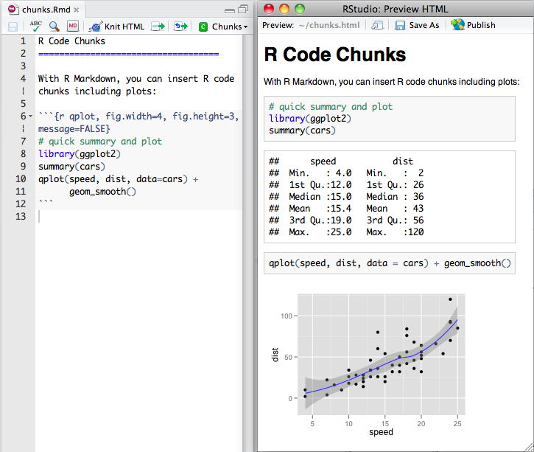
Jupyter/IPython notebook / RStudio
✔Versatile, annotation, sharing
✖ Installation

Slide 47
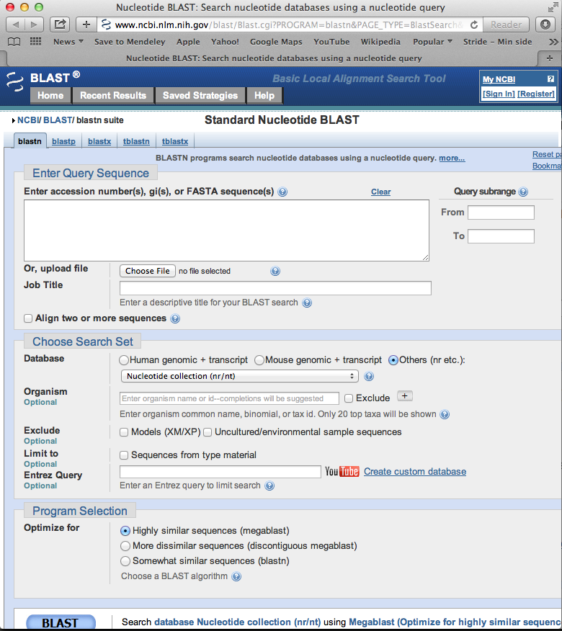
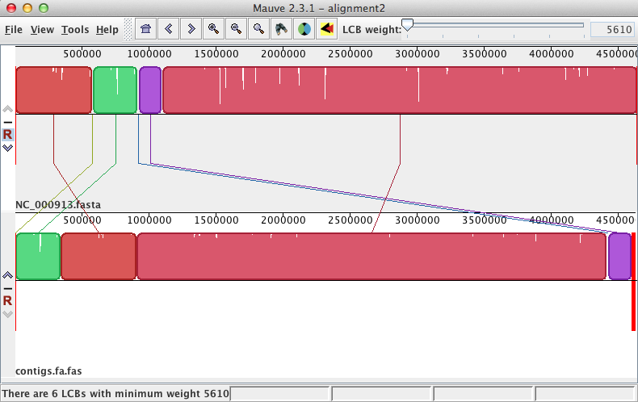
Tool-specific graphical interface
✔No installation, documentation
✖ Each interface different, do one thing only, lack of interoperability (‘piping’)

Slide 48
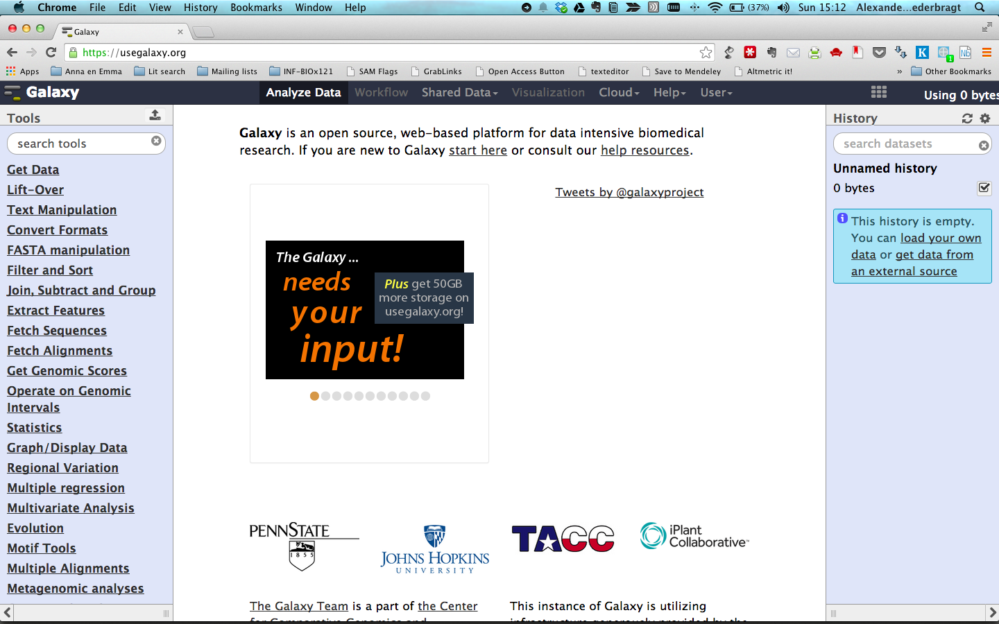
Web-based graphical analysis framework
✔Powerful, unified interface, reproducibility
✖ Does it have your tool?

Slide 49

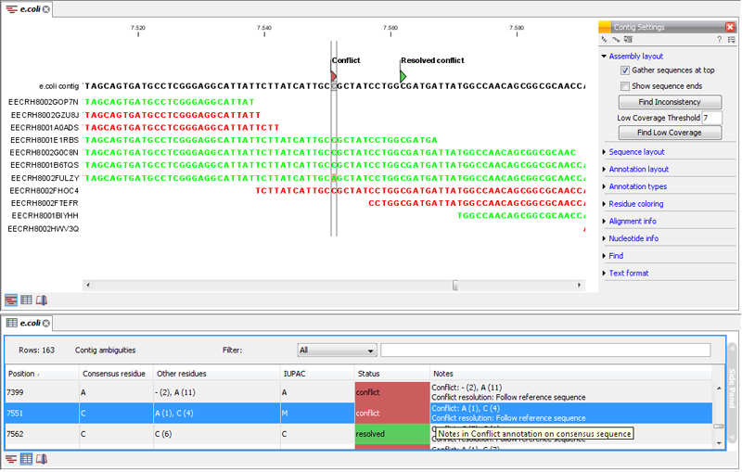
Commercial analysis software
✔Typically very user-friendly, good support
✖ Lock-in, not transparent, often hard to customize

Slide 50
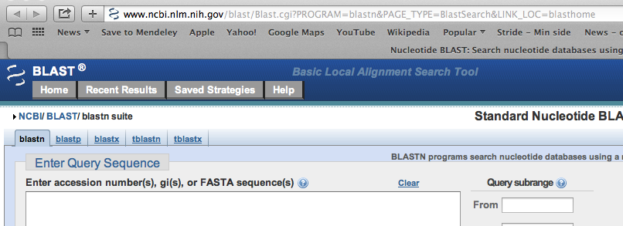
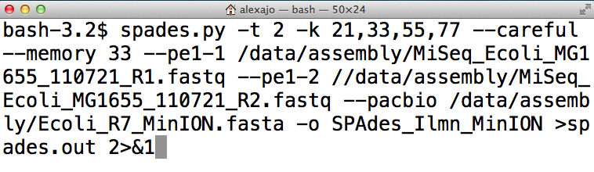
What's best for you?
Bioinformatics = low priority
Web-based solutions
Basic command line to run programs

Slide 51
What's best for you?
Bioinformatics = important, but intermittent
Web-based solutions
IPython notebook
R
Basic command line to run programs

Slide 52
What's best for you?
Bioinformatics = your life
Programming language
More advanced command line

Slide 53
Conclusion
Use the simplest (for you) tools suited for the job!
Do what is effective, not what looks efficient (cool)
It's always good to learn, but it's not necessarily best spent effort

Slide 54
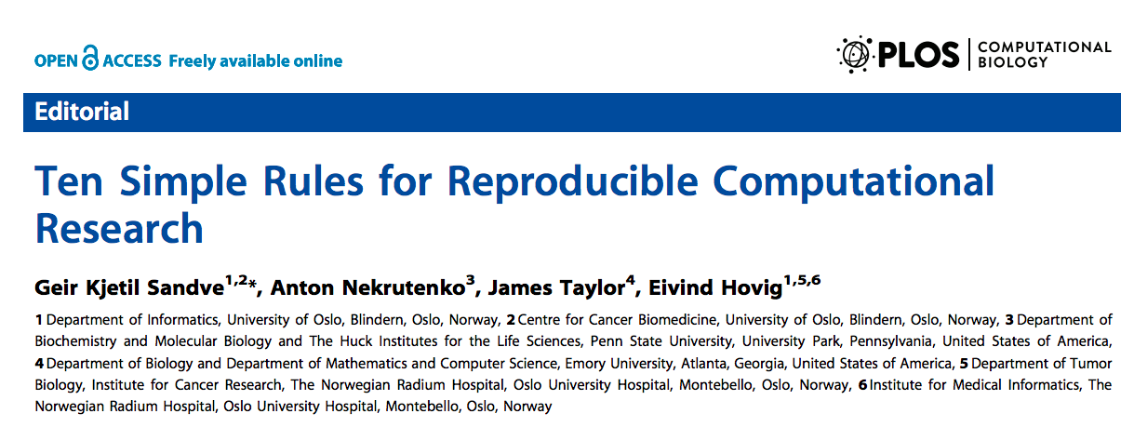
How to become an efficient bioinformatician
http://software-carpentry.org
doi:10.1371/journal.pcbi.1003285

